Slide 1



Welcome
to
My Presentation
FARIA ZAMAN ANAMIKA
ID: 0242320007121330
SECTION: 232 F
Topic: Modern Technologies in Egg Grading and Packaging.

Slide 2
CONTENTS
  INTRODUCTION
  IMPORTANCE (NUTRITIONAL/ECONOMICAL)
  MECHANISM/PRODUCTION PROCEDURE
  APPLICATION/USE
  CONCLUSION
  REFERENCES

Slide 3

INTRODUCTION
  EGG GRADING & PACKAGING ENSURE QUALITY, SAFETY & CONSUMER TRUST.
  MODERN TECHNOLOGIES HAVE MADE THE PROCESS FASTER AND MORE ACCURATE.

Slide 4
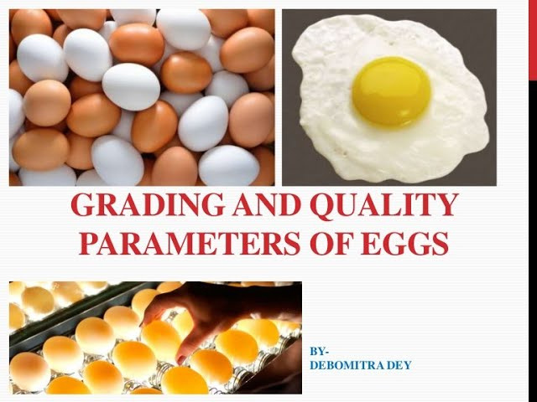

IMPORTANCE (NUTRITIONAL/ECONOMICAL)
NUTRITIONAL:
    ENSURES SAFE, FRESH, CLEAN EGGS
    PREVENTS SPOILED OR CONTAMINATED EGGS REACHING CONSUMERS
ECONOMICAL:
    REDUCES LABOR COST
    BOOSTS CONSUMER TRUST AND BRAND VALUE

Slide 5
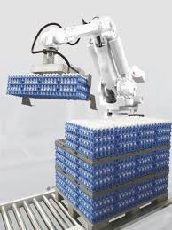
MecHANISM/PRODUCTION PROCEDURE
  EGG COLLECTION
  CLEANING & SANITIZATION
  CANDLING (INSPECTION)
  WEIGHT & SIZE GRADING
  SHELL INSPECTION (VISION SYSTEM)
  AUTOMATIC PACKING
  LABELING & CODING
  STORAGE & DISTRIBUTION
APPLICATION/USE
  USED IN COMMERCIAL EGG FARMS AND POULTRY INDUSTRIES
  ENSURES COMPLIANCE WITH SAFETY STANDARDS (USDA, FAO)
  REAL-TIME QUALITY CONTROL IN LARGE-SCALE PRODUCTION

Slide 6
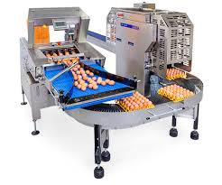
CONCLUSION
  TECHNOLOGY IMPROVES GRADING SPEED, HYGIENE, AND ACCURACY
  SUSTAINABLE PACKAGING ADDRESSES ENVIRONMENTAL CONCERNS
  A NECESSITY FOR MODERN POULTRY INDUSTRIES GLOBALLY
REFERENCES
  FAO. (2021). THE FUTURE OF FOOD AND AGRICULTURE.
  USDA. (2020). EGG GRADING MANUAL.
  MOBA GROUP. (2023). EGG GRADING AND PACKING SYSTEMS.

Slide 7

THANK'S FOR WATCHING

